Slide 1
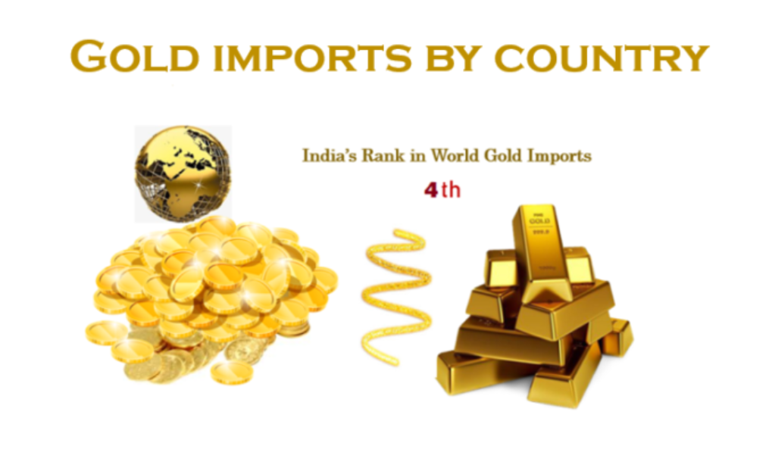
Introduction
India is importing gold from more than 40 countries across the world. India’s gold import represents 8.4% of world imports during the year 2016. India recorded gold import value of USD 22944490 thousand in 2016.

Slide 2
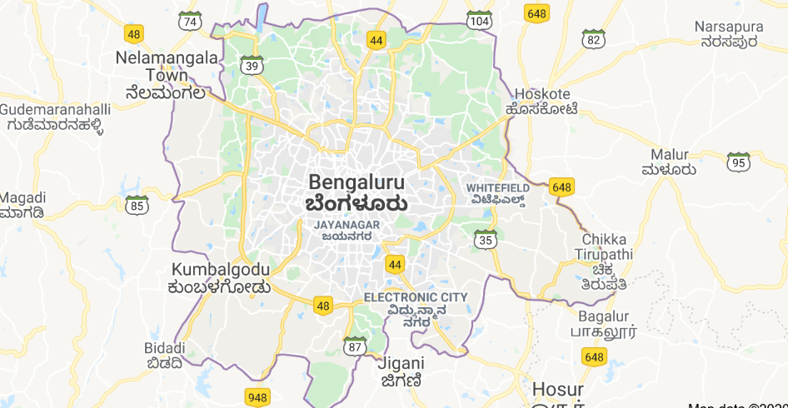
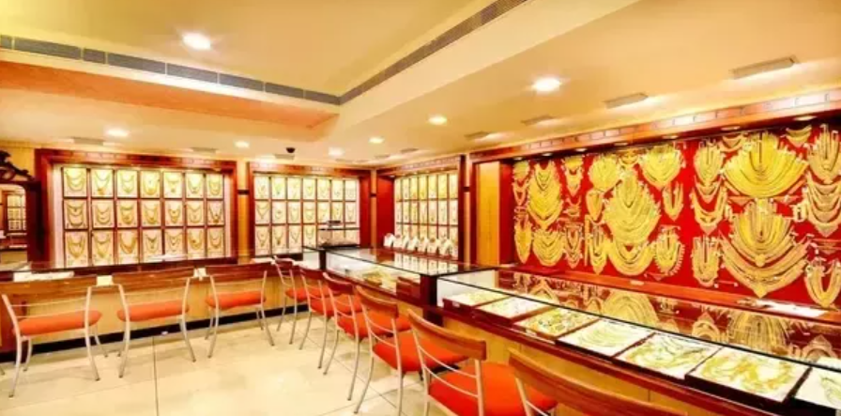
Background
?
?
?
?
Where can be the next Jewelry Shop in Bangalore?

Slide 3



Probable Interested Parties
Above and many more jewelers might be interested in establishing a new brick and mortar shop

Slide 4
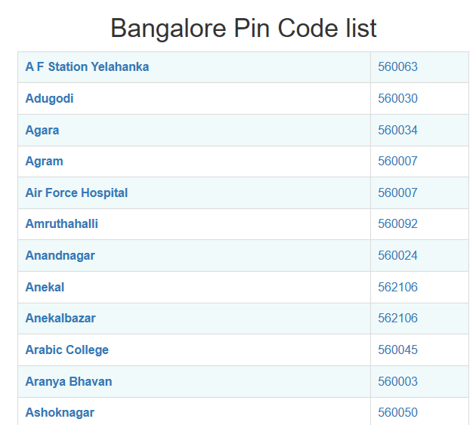
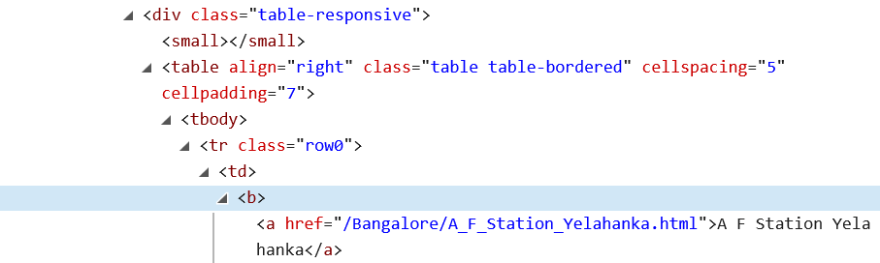
Gather information-1
https://indiamapia.com/Bangalore.html
Inspect Element
Use BeautifulSoup package to get into a list pincode and area name
Data parsing from html file

Slide 5
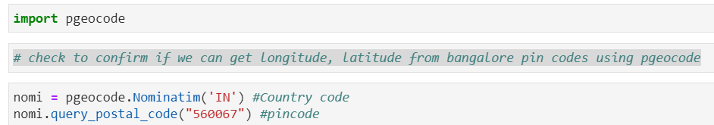
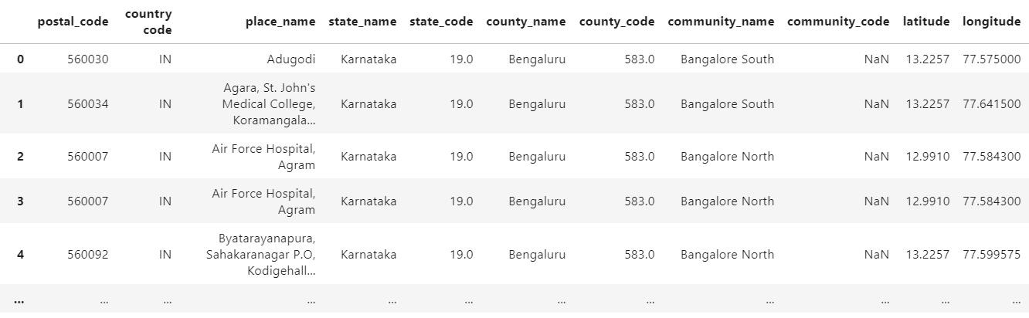
Gather information-2
Gather location latitude, longitude for a given pincode in Bangalore

Slide 6
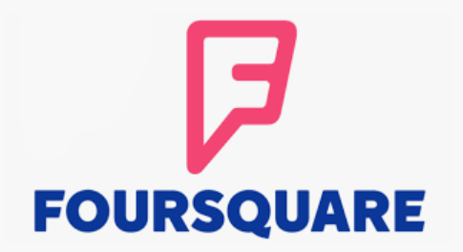
FOURSQUARE API searches
Jewelry | Showroom | art | Shopping Mall | bank | Ice Cream Shop | Clinic | park | gas station | restaurant | coffee | School
Using developer login in Foursquare, gather count of number of each of above search criteria

Slide 7
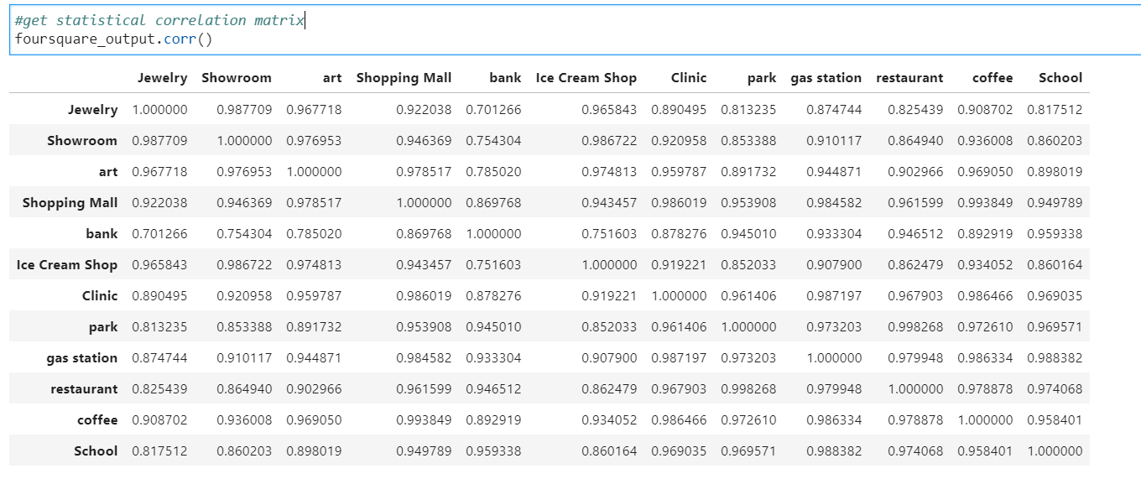
Inferential statistical testing
Good correlation indicates our other search criteria choices are correct

Slide 8
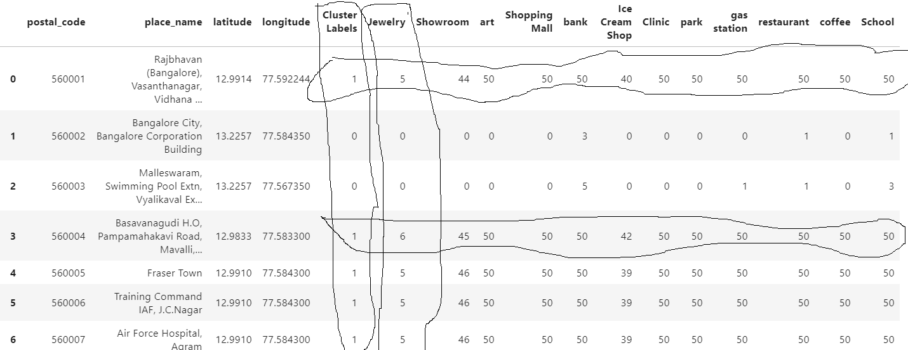
Clustering
K-means clustering used. A cluster refers to a collection of data points aggregated together because of certain similarities.

Slide 9
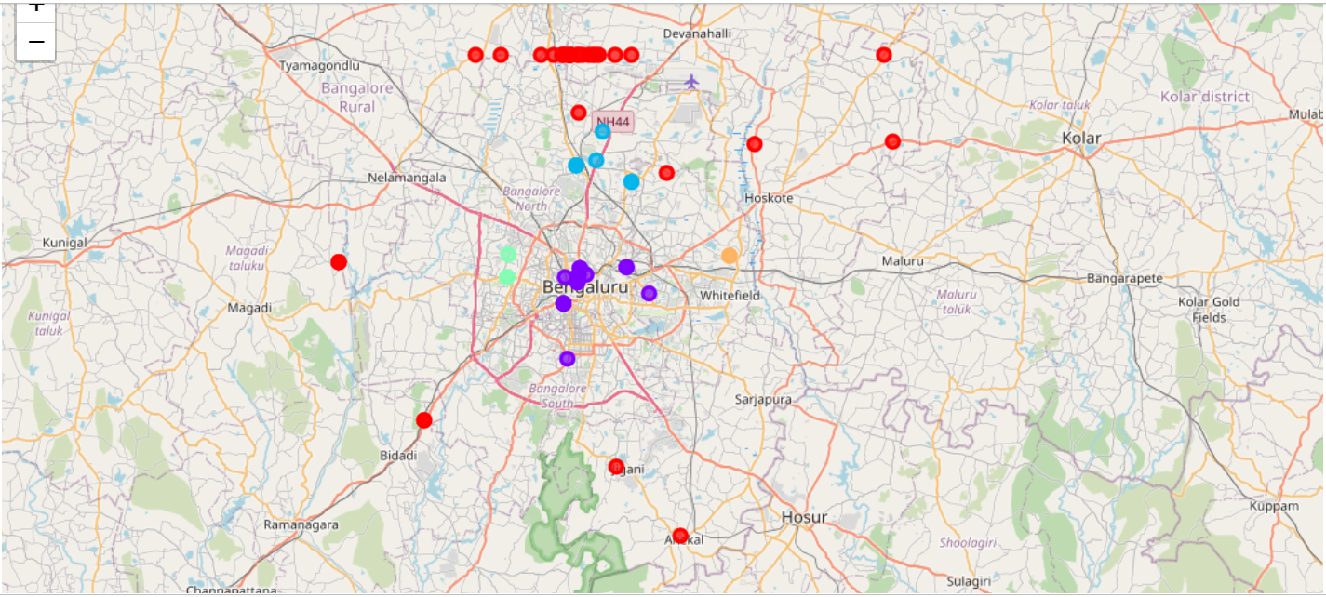
Folium map with color coded clusters
Figure1: Folio map of clustered pin codes of Bangalore based on #of jewelry shops, car/bike show rooms, restaurants, banks etc in a neighborhood (extracted from thousands of FOURSQUARE search queries)

Slide 10
Recommendations
JP Nagar with pincode of 560078 will be a good choice for setting up another gold shop. Notice the strong correlation between the presence of jewelry shop and showroom in the same pincode area. This is successfully captutred in the grouping by the clustering algorithm with cluster-label =1.

